Slide 1
In-class Exercise 07 - Median Filtering
Dhiren Gupta
-800902466

Slide 2
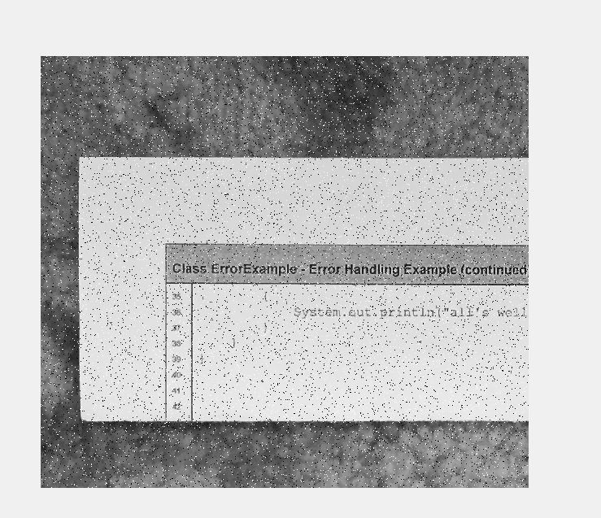
Input Image

Slide 3
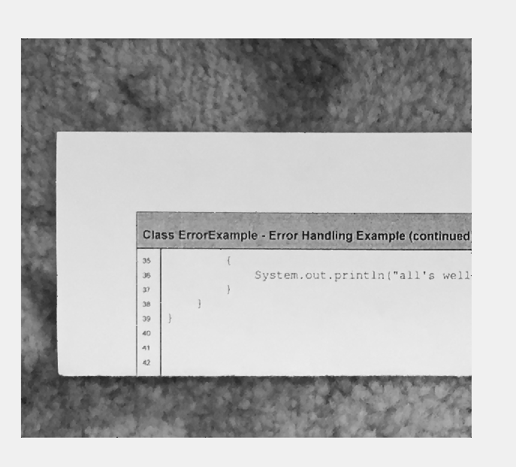
Window Size=3*3

Slide 4
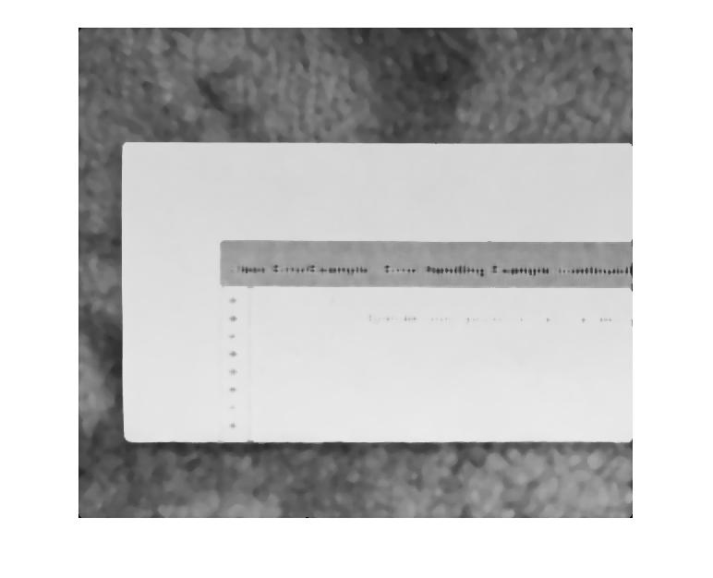
Window Size 11*11

Slide 5

Window size 31*31

Slide 6
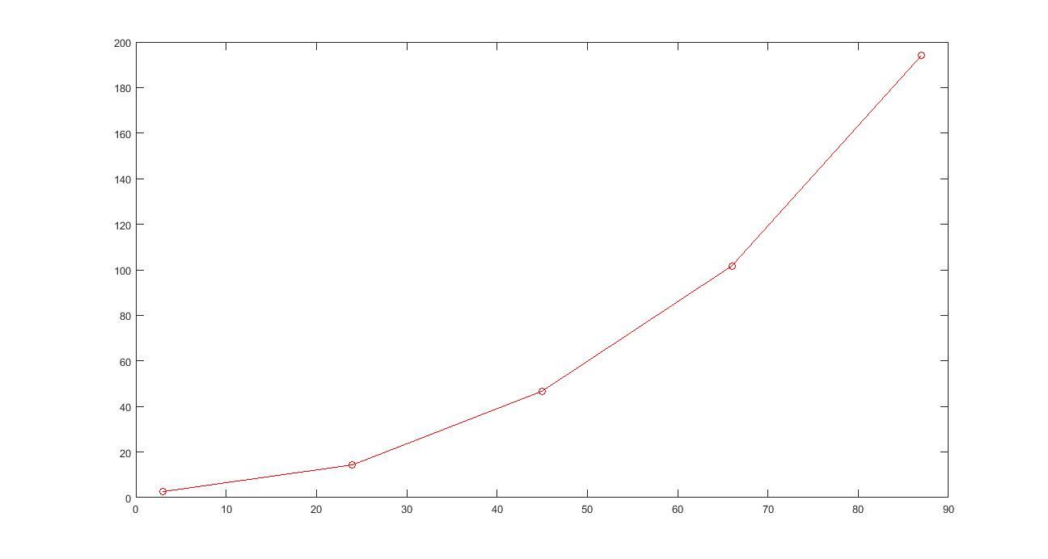
Plot for W = 3:21:101;

Slide 7
Thank You

